Slide 1

Presented by Lynelle Chan
Notes:
Hello Mr. Goren, thank you so much for taking the time to speak with me. With the growth of LMP, it is a very exciting time and I hope my recommendations will be able to assist with the concerns of the human resources team.

Slide 2
How Do We Lower Turnover?
Notes:
When Alex and I initially spoke, it appeared that the big question was how do we lower employee turnover? Alex had provided me with the dataset that was updated this past January, and I began to analyze the data for the provided years (2012, 2013, and 2014).

Slide 3
Questions to explore...
How does LMP’s turnover compare to industry standards?
Has employee turnover increased YOY?
Where can we improve?
What can be done moving forward?
Notes:
During the analysis, I focused on 4 questions:
1) How does LMP’s turnover compare to industry standards
2) Has employee turnover increased YOY?
3) What areas can we improve
4) What can be done moving forward

Slide 4
Some things to keep in mind...
Assumptions
Separation procedures from 2012 is still in effect
The large acquisitions in 2013 and 2014 have caused skewed results
Limitations
Data was not industry specific - compared against the US Bureau of Labor Statistics private industry
Data for the turnover percentages were determined by manipulation of the term reason column - all employees with a term reason of “null” are still employed with LMP.
Notes:
As I began to explore, I did keep in mind that the most recent update to the separation procedures were from 2012 and that the human resources team is ready to make any changes if warranted. I also kept in mind the large acquisitions that LMP had over 2013 and 2014.
Unfortunately, the dataset didn’t have all of the elements that I would need to provide a more extensive analysis. One of the limitations was that the data was not industry specific and I was unable to analyze employee turnover by specific industry. However, I overcame this by comparing our turnover percentages to the US Bureau of Labor Statistics private industry turnover percentages.
Another limitation in the data was that it wasn’t directly clear which employees were still employed. In order to obtain the information needed to perform the analysis, I utilized the term reason column and assumed that all employees without a term reason are still employed with LMP.

Slide 5
Involuntary vs. Voluntary
Year | Total Separations | Involuntary | Involuntary Percentage | Voluntary | Voluntary Percentage
2012 | 936 | 246 | 26.3% | 690 | 73.7%
2013 | 12634 | 3066 | 24.3% | 9568 | 75.7%
2014 | 15872 | 4082 | 25.7% | 11790 | 74.3%
Notes:
From 2012 to 2014, LMP has had a total of 1.3 million employees that have worked in the various business units. Of this total, there has been about 30,000 employees that have been separated from the company over the last 3 years. In this slide, I have provided the total separations by year, and how many of these separations were either voluntary or involuntary. As you can see, there was a significant increase in separation in 2013 and 2014.

Slide 6
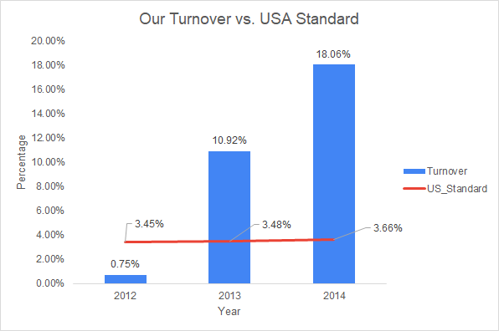
Is employee turnover higher than US private industry standard?
YES!
Source: https://www.bls.gov/bls/news-release/jolts.htm
Notes:
So is employee turnover higher than US standards? The short answer is yes.
As mentioned earlier, one of the limitations of the dataset was that it did not specify what industry that the employee worked in. As there are many types of business within LMP, I determined that the best course of action was to compare our turnover percentages (which is represented by the blue bars in the chart) against the private industry standards provided by the US Bureau of Labor Statistics (which is displayed as the red line). As you can see, LMP had significantly higher turnover than US standards.

Slide 7
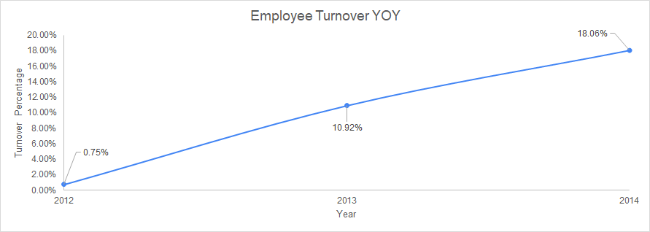
Has employee turnover increased YOY?
Absolutely!
While the acquisition is a large consideration, there are still areas to improve!
Notes:
Has employee turnover increased YOY? Absolutely!
While it is true that turnover has increased YOY, it is also important to remember that there were significant transitions that were made during the acquisition process. This caused the turnover percentages to be more inflated than what is typically seen. However, there are still some areas of improvement that the analysis uncovered.

Slide 8
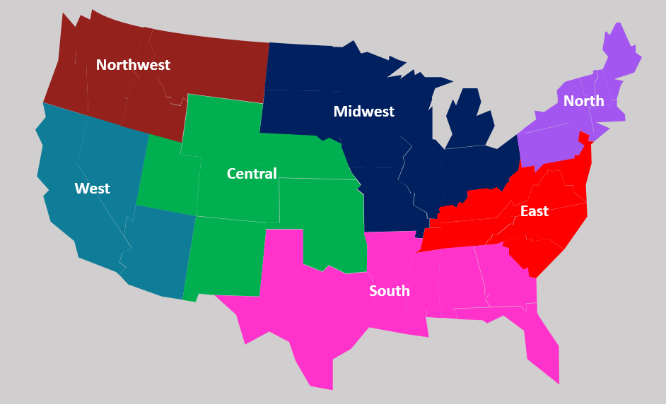
Region
Separation By Year
 | 2012 | 2013 | 2014
Central | 17.1% | 15.9% | 20.1%
East | 8.3% | 8.6% | 8.7%
Midwest | 14.6% | 14.4% | 18.0%
North | 14.6% | 16.1% | 22.0%
Northwest | 21.0% | 20.5% | 23.7%
South | 16.0% | 15.6% | 22.3%
West | 8.2% | 8.9% | 10.9%
https://www.slideegg.com/free-editable-us-map-with-states
Notes:
LMP is has 7 regions that our business units are spread across (as shown in the map on the left).
What I noticed was that the separation rates varied quite a bit between different regions. However, there were 4 regions that did make up a big portion of the turnover for each year (Northwest, Central, South, and North regions). As shown in the chart on the right, the transitions for the executive teams of the acquired companies really began in 2012 and there were quite a few separations. While some transitions for non-executive level employees began in 2013, the slight decrease in turnover percentage indicates that we were able to retain a fair amount of the employees.
Unfortunately, we did see a significant increase in turnover during 2014. While there may have been outside factors, like family obligations or availability of positions in different companies that came into play, it would be helpful to understand if there was anything that we could have done differently.

Slide 9
What should we do?
Employee satisfaction surveys
Immediately after probation period ends
Bi-Annual for all other employees
Exit interviews that includes questions that are focused on:
Reason for leaving
Company culture
Training and development
By measuring the data provided by the recommendations above, we can begin to understand what our employees need in order to be happy and create action plan items based on the findings.
Notes:
The data only disclosed whether a separation was voluntary or involuntary. In order to ensure that LMP is maintaining morale, I would recommend performing employee satisfaction surveys immediately after the probation period for employees to obtain feedback about our training process. I would also recommend performing bi-annual satisfaction surveys for all other employees and exit interviews for separating employees. Once we have this data, we can begin to search for trends to help determine what our employees value most.

Slide 10
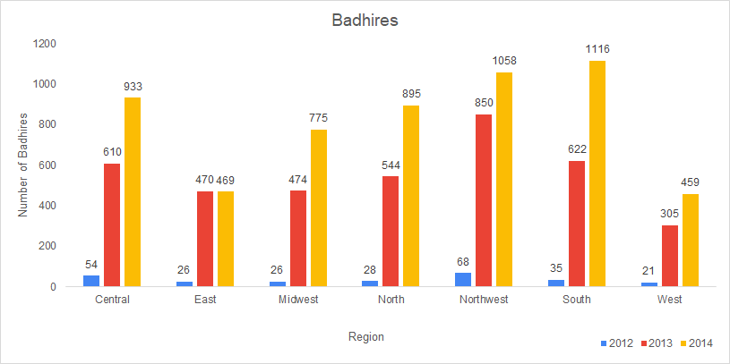
The regions with the greatest number of badhires is the South, Northwest, Central and North.
Notes:
Speaking of separations, another area that we have seen a large increase is bad hires. From my discussions with Alex, a bad hire is defined as someone who was not able to perform to a level that the position may have required. This chart displays the number of bad hires each year by region. One correlation that was noticed is that while there was an increase in 2013 and 2014 for all regions, the regions that had the greatest amount of turnover also had the greatest number of bad hires. With the increase in bad hires, it could indicate that there may be a morale issue that could be explored further if the data was available.

Slide 11
What should we do?
Determine where the employee was hired from
Review onboarding procedures and ensure they are following best practices
Create a standardized form for each type of disciplinary action (verbal, written, final)
Once we have the form is utilized, we will be able to have a methods to measure the factors of a potential badhire and what action steps need to be complete (i.e. update training protocols, use different interview techniques, etc.).
Notes:
In order to understand why there is such an increase in bad hires, I would recommend a review of all areas of the hiring process. First, we should determine what avenue was used to hire these particular employees (i.e. job fairs, job postings, etc.). Typically, this information can be found in the application as the “how did you hear about this position” section and can easily be extracted if the application process is digitalized. A second recommendation is to review the onboarding procedure to ensure that best practices are being followed. The final recommendation would be to work with our IT department to create a digital form that can be used for each phase of the disciplinary process. By collecting this data, we can further analyze trends to see if there needs to be modifications with processes and procedures relating to the interview process, training and ongoing managerial support.

Slide 12
In Conclusion...
By creating a standardized form that is completed for each disciplinary action, we can begin to understand what are some factors that are causing employees to become “bad hires” and begin to determine if some of our best practices need to be revised.
With the data collected from employee satisfaction surveys and exit interviews, we will be able to determine what matters most important to our employees and create an action plan to ensure employees stay engaged and productive.
Notes:
So as a recap, in order to lower our turnover, we really need to focus on what is most important to our employees in order to maintain morale. First, we can review the data to understand if there are controllable factors to minimize the number of “bad hires” and determine if there are some processes that may need revision. We can also utilize the data collected from the employee satisfaction surveys and exit interviews to explore trends and create an action plan to ensure that employees stay engaged and productive. Once this data is collected it would be my pleasure to assist further.

Slide 13
Questions?
Notes:
At this time, I would like to thank you and open the floor for any questions.

Slide 14
Sources
Title | Site
US Bureau of Labor Statistics | https://www.bls.gov/bls/news-release/jolts.htm
Logo design | https://www.vectorstock.com/royalty-free-vector/circle-shape-company-logo-vector-19974429
Exit Interviews | https://www.glassdoor.com/employers/blog/7-must-ask-exit-interview-questions/
Employee Satisfaction Surveys | https://www.tinypulse.com/blog/questions-for-employee-satisfaction-surveys

